Slide 1
R package workflows

Slide 2
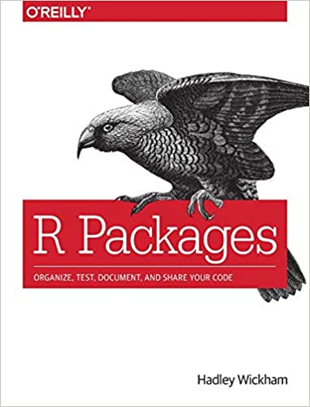
Chapter 5
https://r-pkgs.org/Workflow101.html

Slide 3
Create a package
Pick a name
usethis::create_package()
RStudio Project vs. active usethis project

Slide 4
“lather, rinse, repeat”
Make changes
load_all()
test
devtools::load_all()
Cmd+Shift+L (macOS), Ctrl+Shift+L (Windows, Linux)

